Slide 1

Data base dilemma: Navigating the NoSQL vs. SQL
Yasmine Belarbi

Slide 2
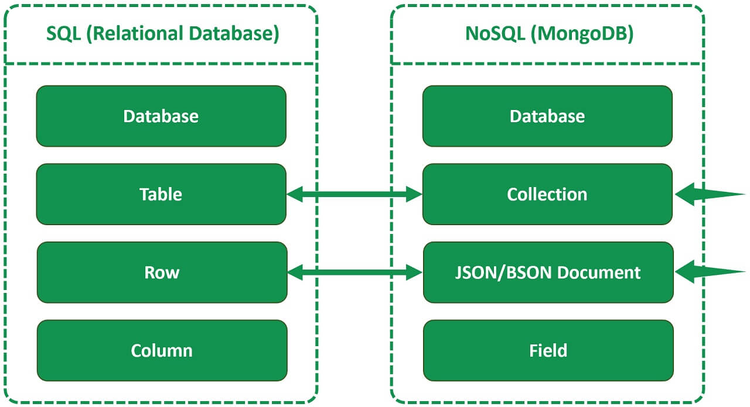
Introduction to MongoDB and SQL
MongoDB is a NoSQL database that uses a document-oriented data model, whereas SQL is a traditional relational database management system (RDBMS). MongoDB is schema-less, allowing for flexible data models, while SQL databases have a predefined schema that needs to be followed. MongoDB is well-suited for unstructured or semi-structured data, while SQL is preferred for structured data with complex relationships.

Slide 3
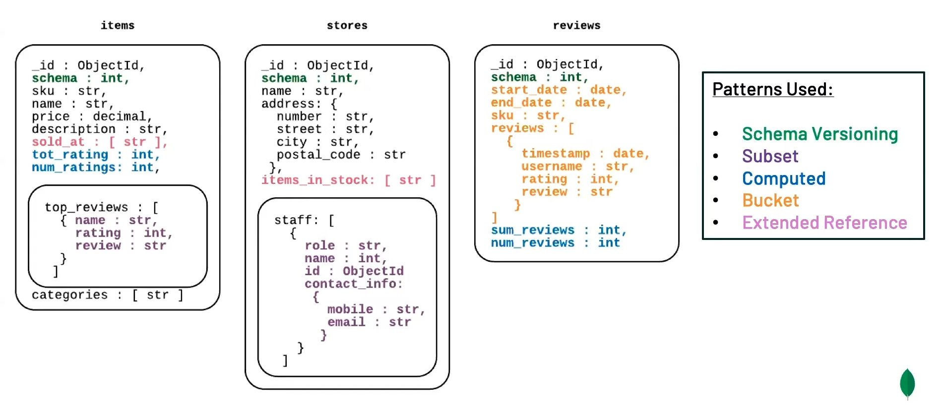
Data Model
MongoDB uses BSON (Binary JSON) to store data, making it easier to work with JavaScript-based application. SQL databases use tables with rows and columns to store data in a structured format. MongoDB supports nested data structures and arrays, providing better support for hierarchical data compared to SQL.

Slide 4
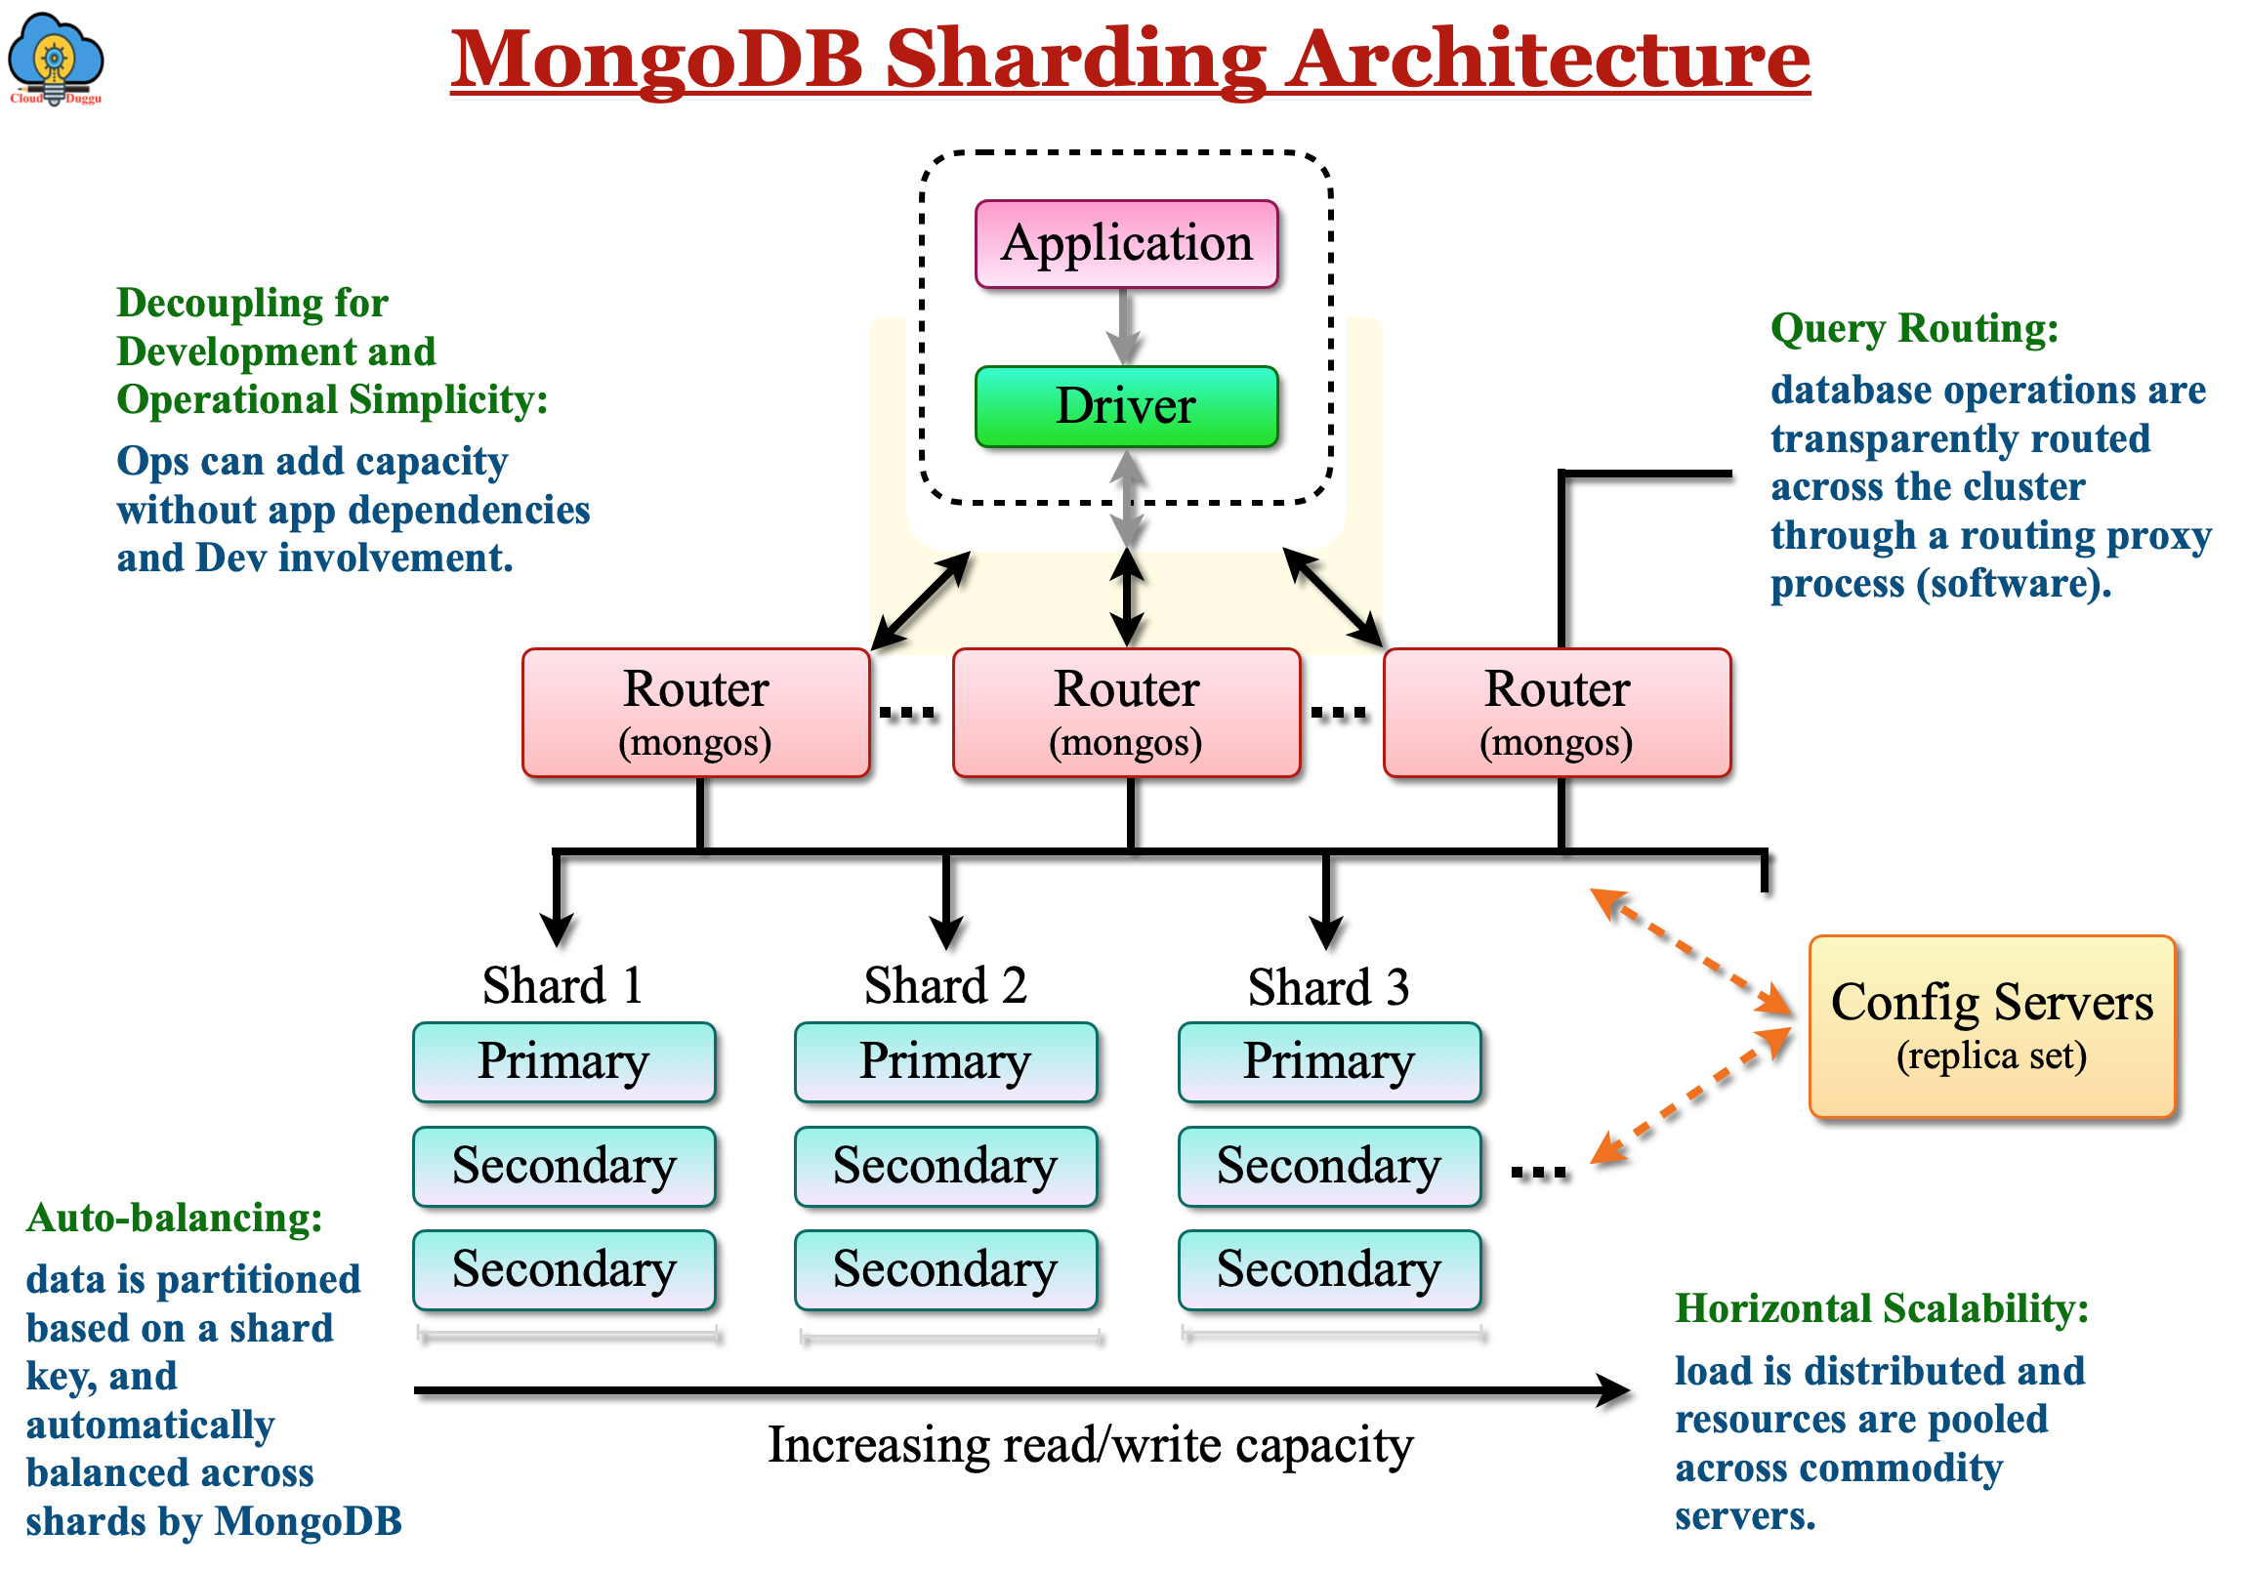
Scalability
MongoDB is horizontally scalable, allowing for distributed databases across multiple servers to handle large amounts of data and traffic. SQL databases typically scale vertically, requiring more powerful hardware to handle increased loads, which can be more costly. MongoDB's sharding capability enables automatic data distribution and load balancing, making it easier to scale compared to SQL databases.

Slide 5
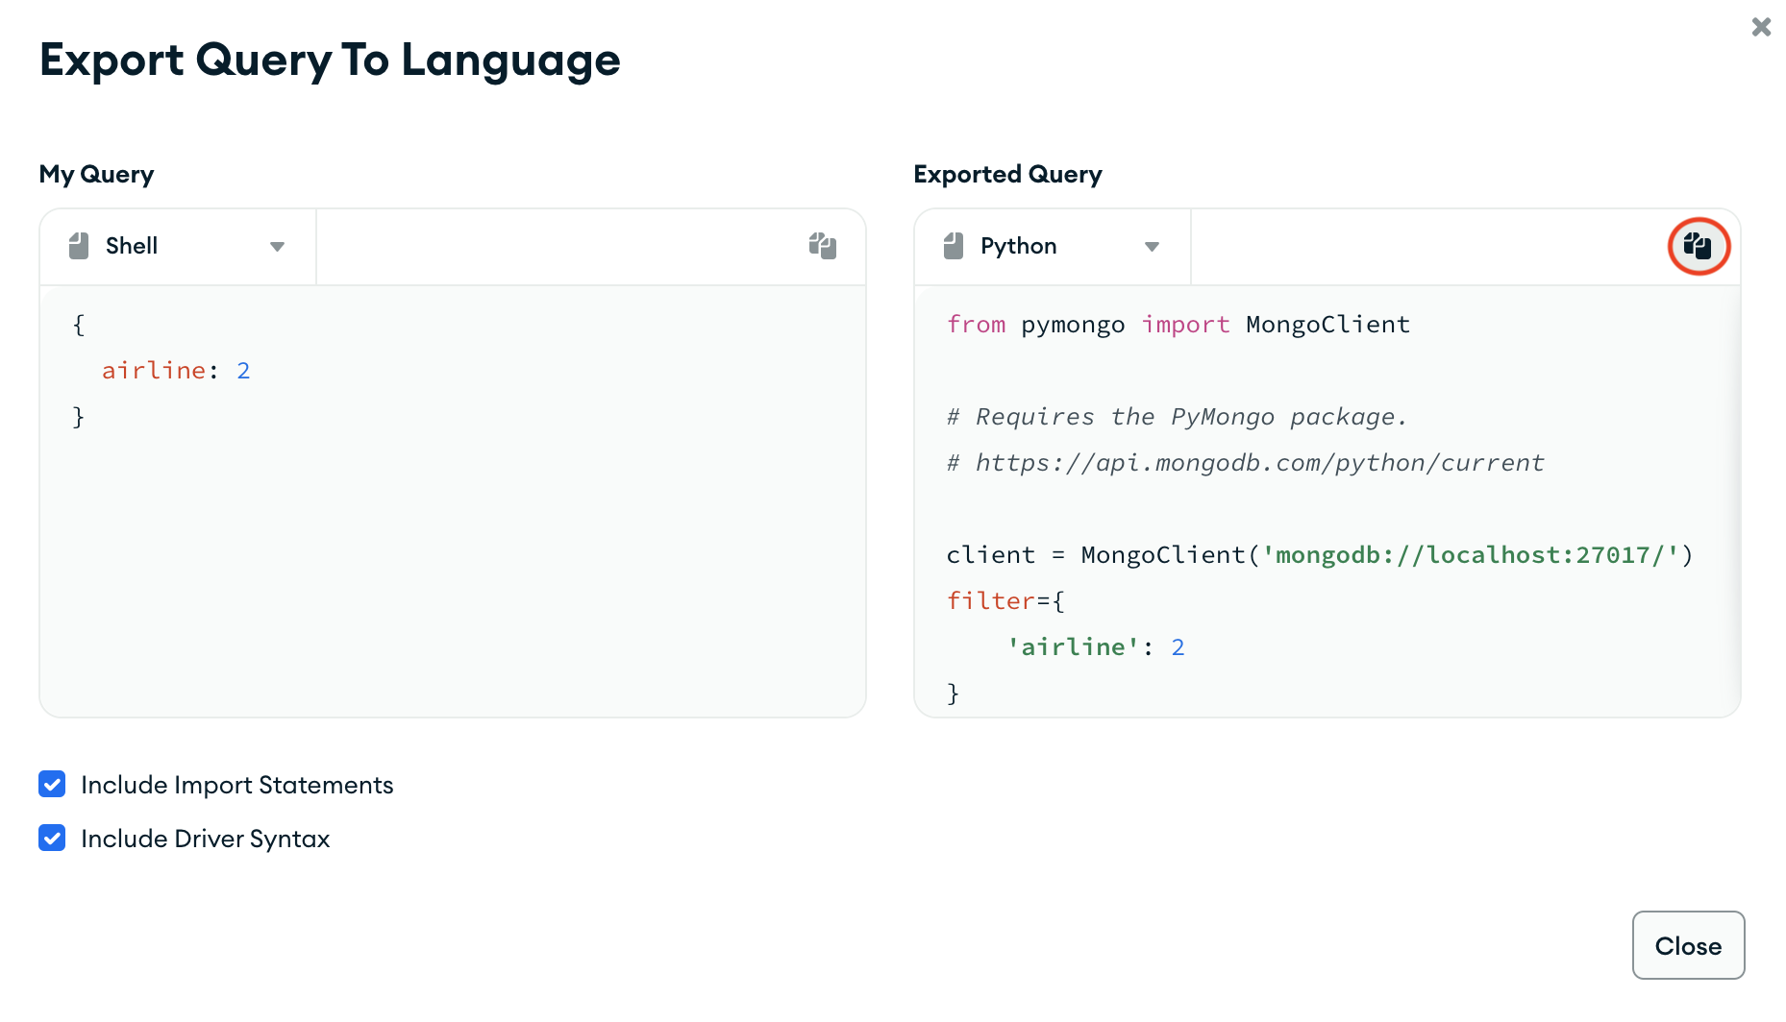
Query Language
MongoDB uses a flexible query language that is similar to JavaScript, making it easier for developers to work with. SQL databases use structured query language (SQL) for querying data, which follows a specific syntax for data retrieval and manipulation. MongoDB's query language supports complex queries and can handle large volumes of data efficiently.

Slide 6
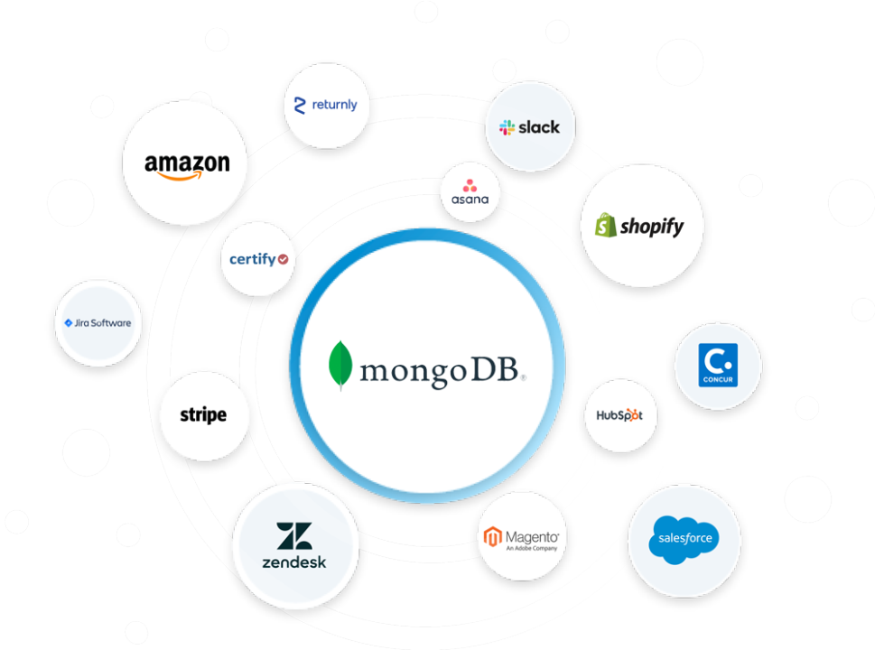
Use Cases
MongoDB is well-suited for applications with constantly changing schemas, real-time analytics, and content management systems. SQL databases are preferred for applications with complex relationships, transactions, and strict consistency requirements. The choice between MongoDB and SQL depends on the specific use case and the requirements of the application.

